Slide 1
Notebooks, PowerShell and Excel Automation
Everything is Awesome
Rob Sewell He/Him, Beard Twizzler, Sewells Consulting Ltd

Slide 2
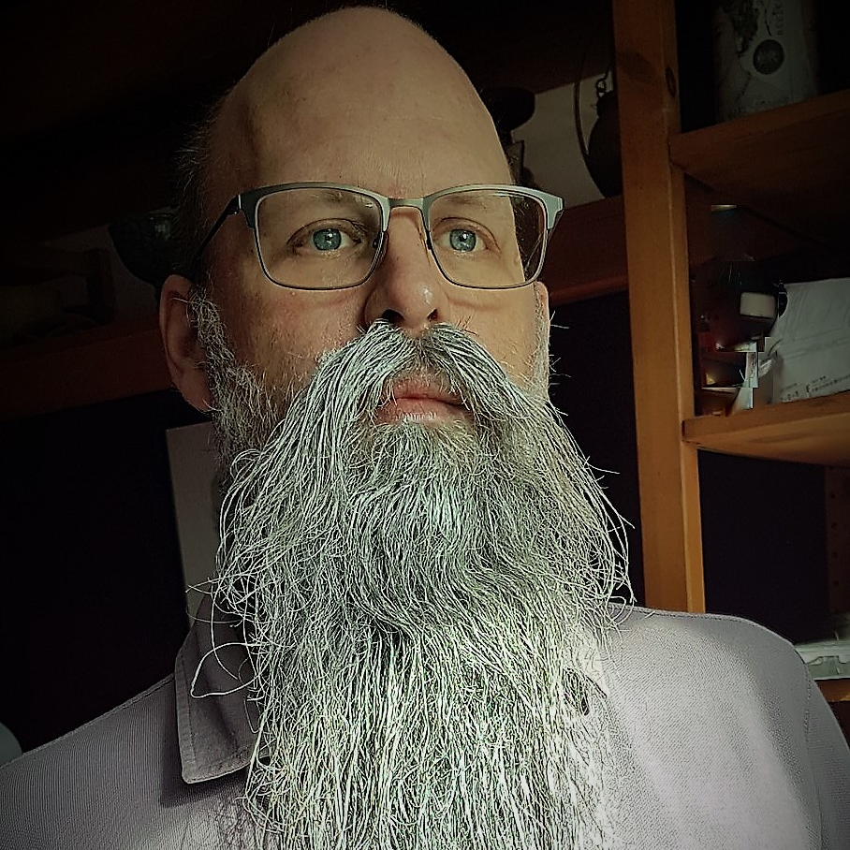

Rob Sewell
Bearded Consultant
Automator
Trainer
Dual MVP
He/Him
Consultant Sewells Consulting Ltd
dbatoolsMoL dbachecks
ADSNotebooks PowerShell Community
Data Community
beard.media\book
@sqldbawithbeard
blog.robsewell.com

Slide 3
Rob Sewell
Bearded Consultant
Automator
Trainer
Dual MVP
Consultant Sewells Consulting Ltd
dbatoolsMoL dbachecks
ADSNotebooks PowerShell Community
Data Community
beard.media\book
@sqldbawithbeard
blog.robsewell.com
Notes:
OBS:SpeakerCircle

Slide 4
Rob Sewell
Bearded Consultant
Automator
Trainer
Dual MVP
Consultant Sewells Consulting Ltd
dbatoolsMoL dbachecks
ADSNotebooks PowerShell Community
Data Community
beard.media\book
@sqldbawithbeard
blog.robsewell.com
Notes:
OBS:SpeakerCircleandSide

Slide 5
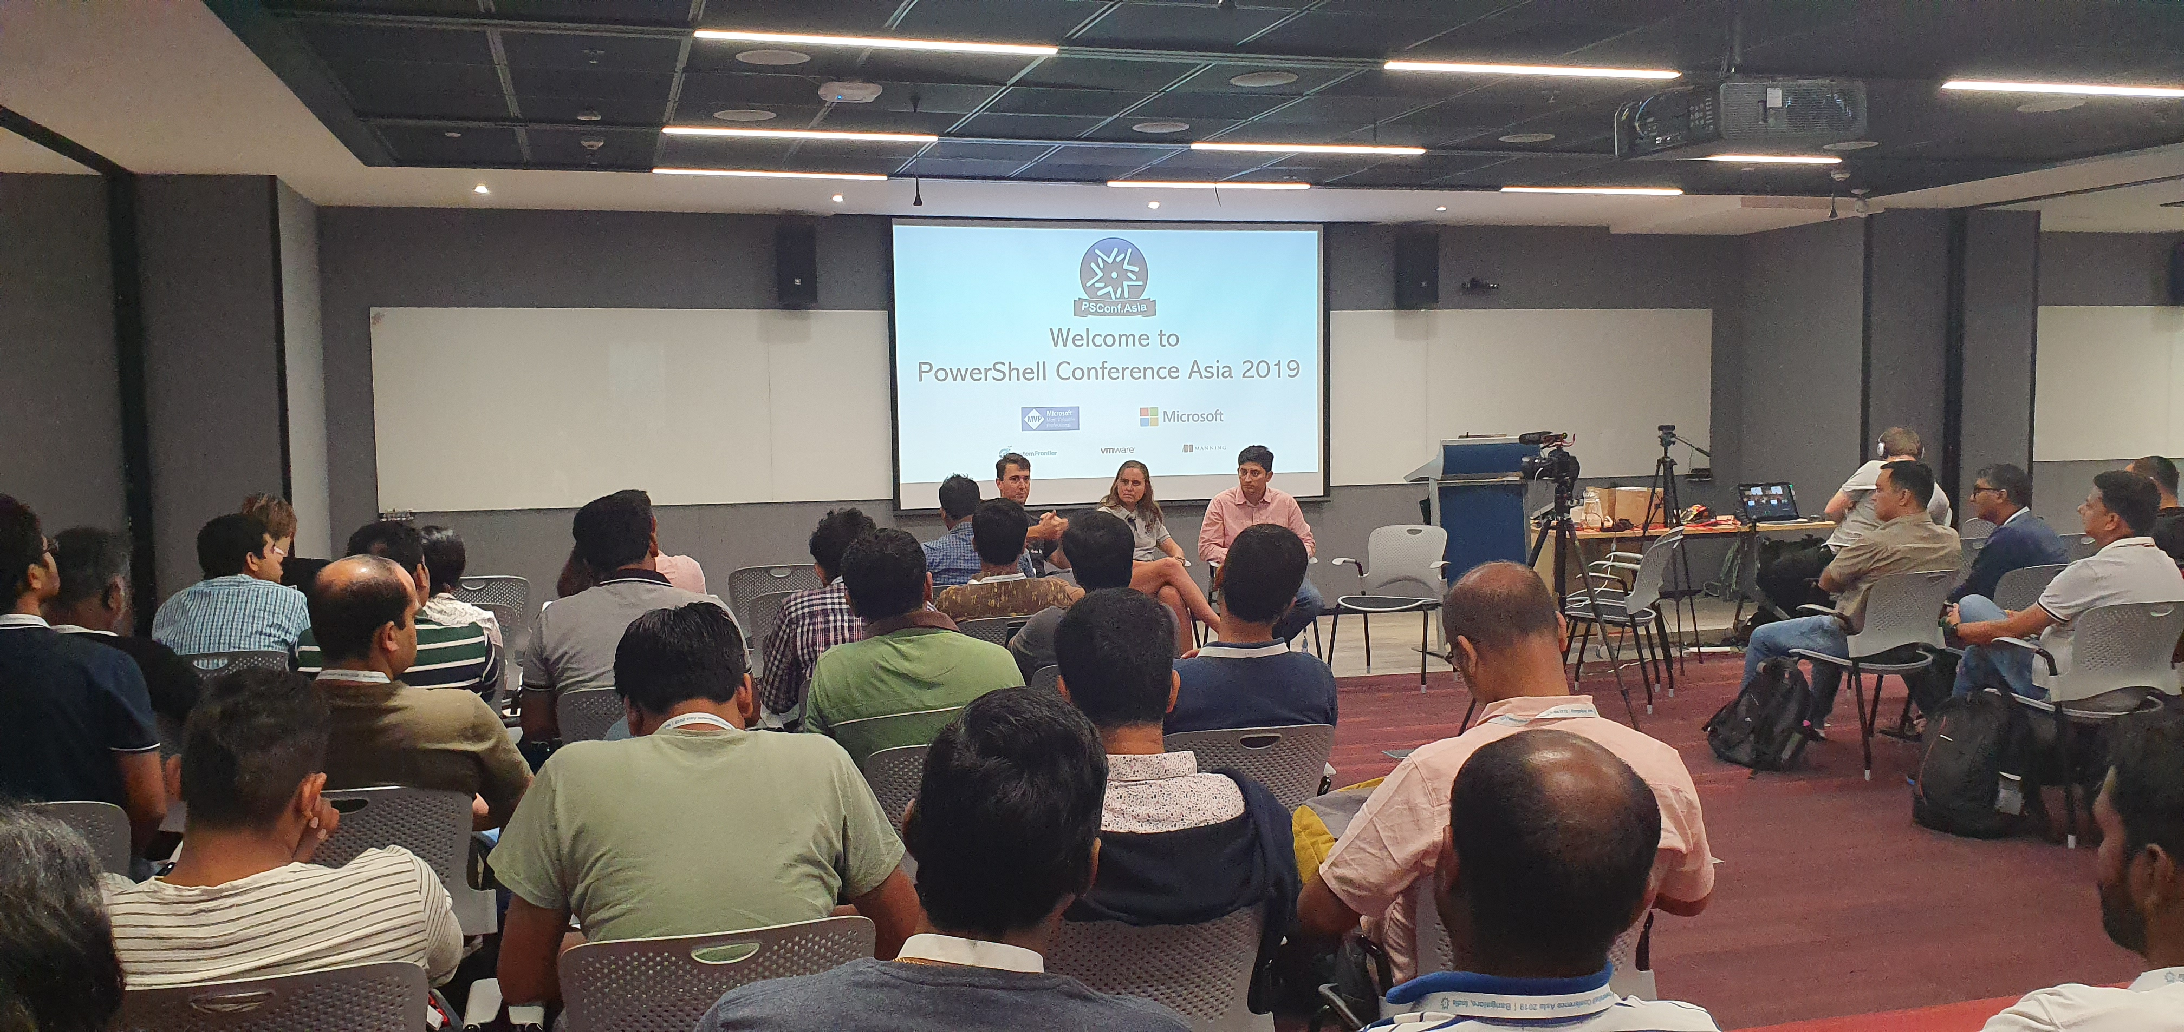
So pleased to be back in India
Notes:
OBS:SpeakerTopRight

Slide 6
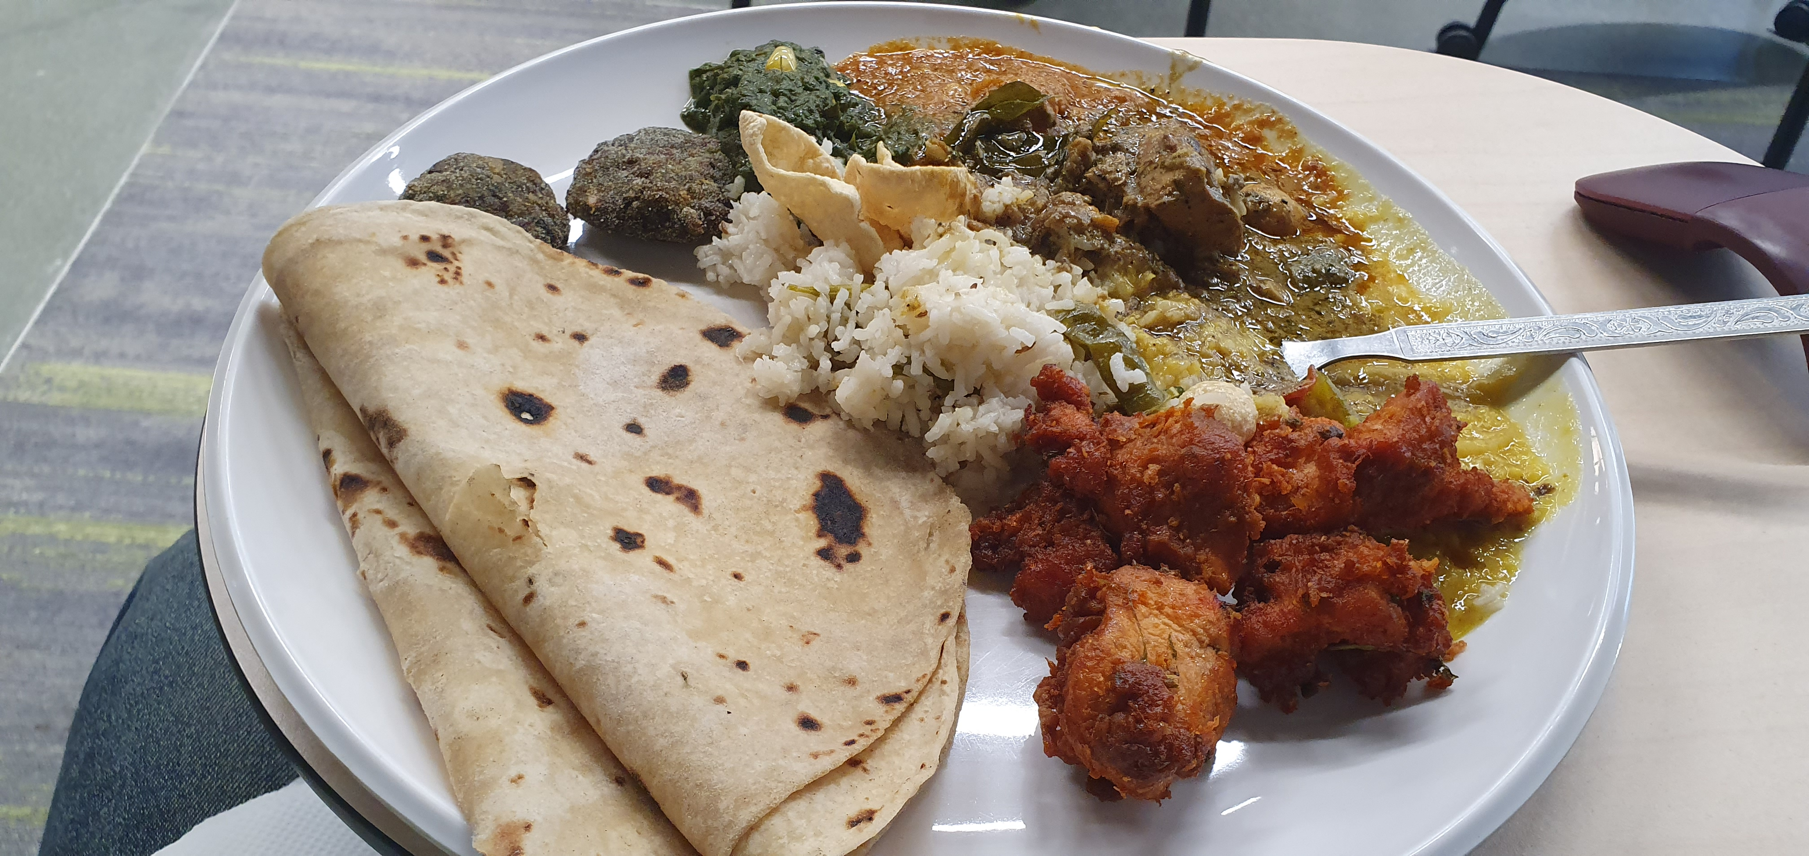
So pleased to be back in India
Notes:
OBS:SpeakerTopRight

Slide 7
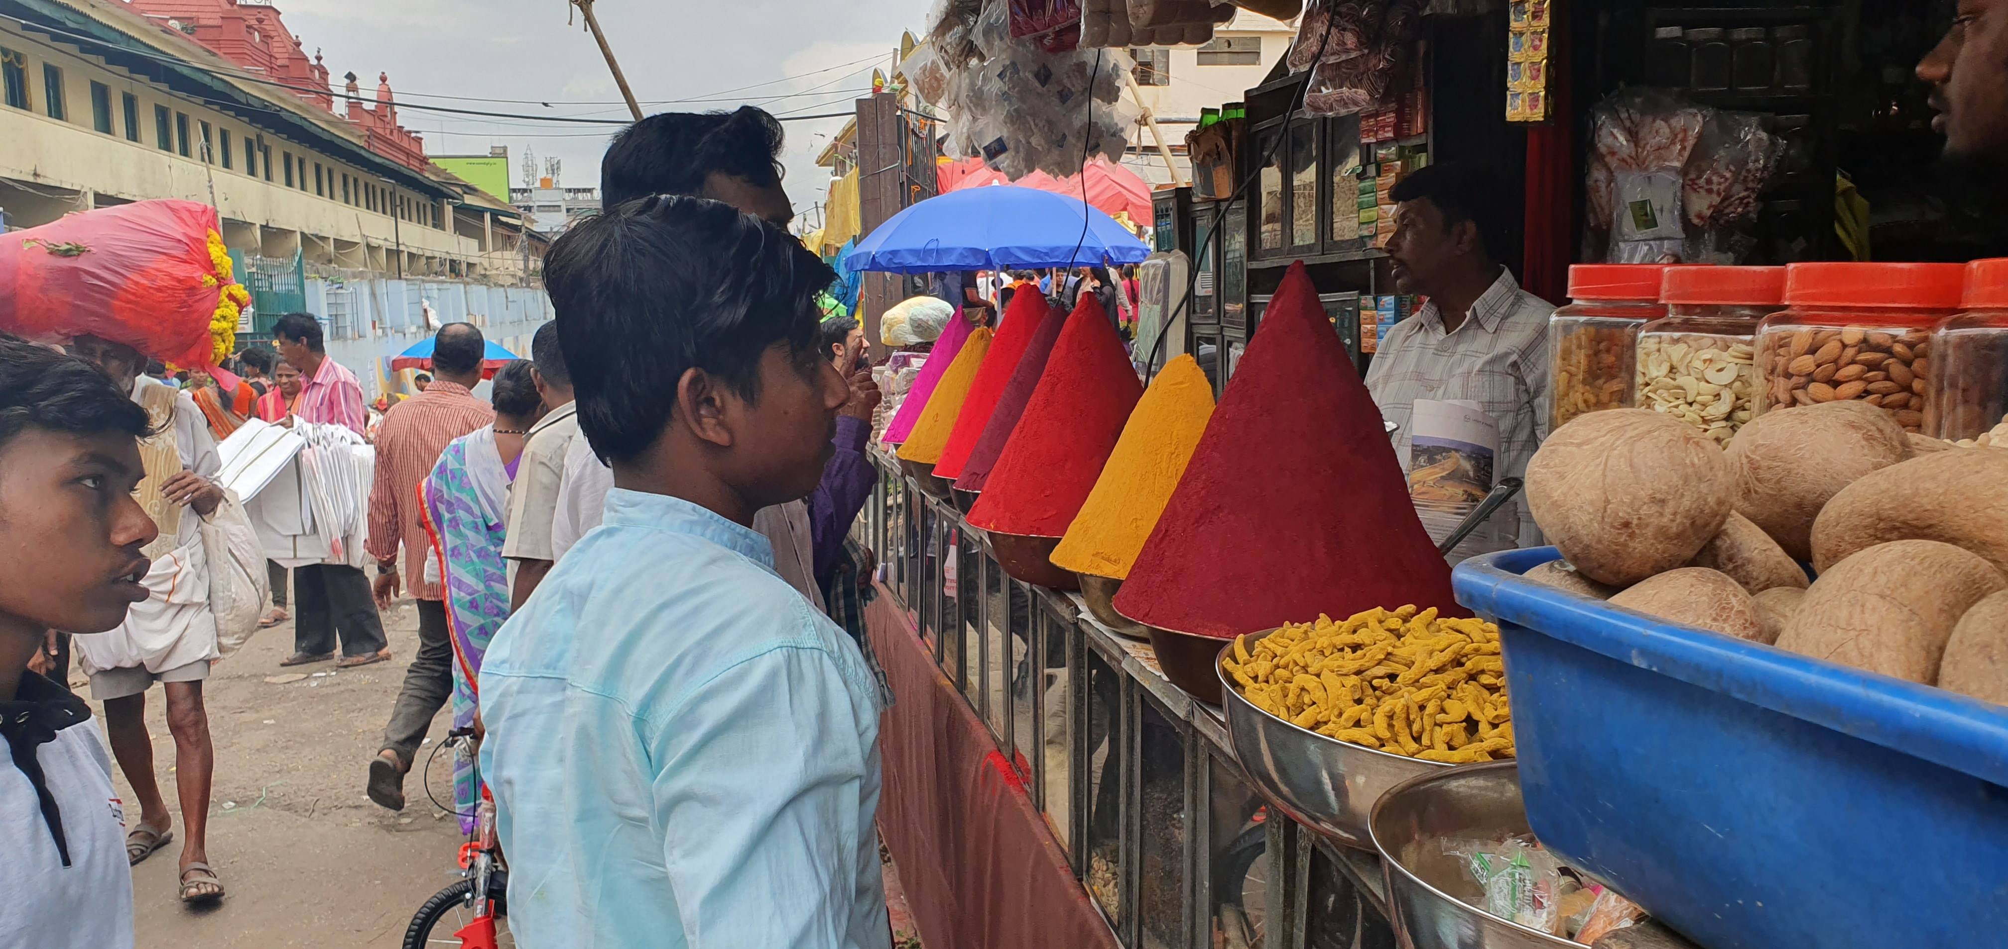
So pleased to be back in India
Notes:
OBS:SpeakerTopRight

Slide 8
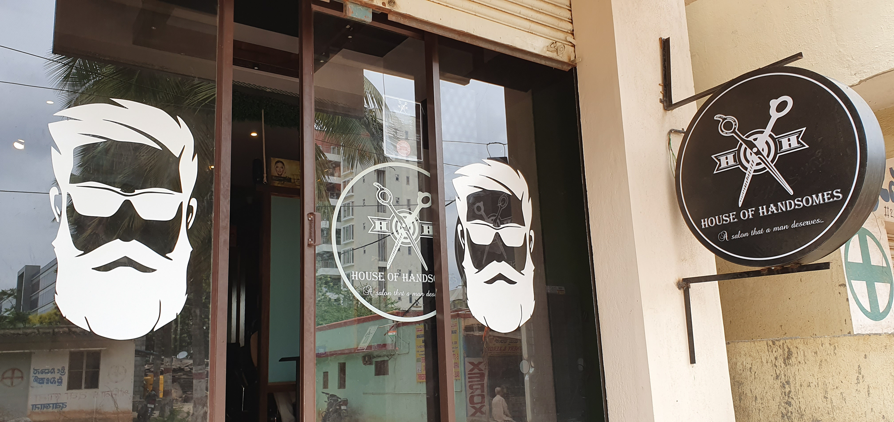
So pleased to be back in India
Notes:
OBS:SpeakerTopRight

Slide 9
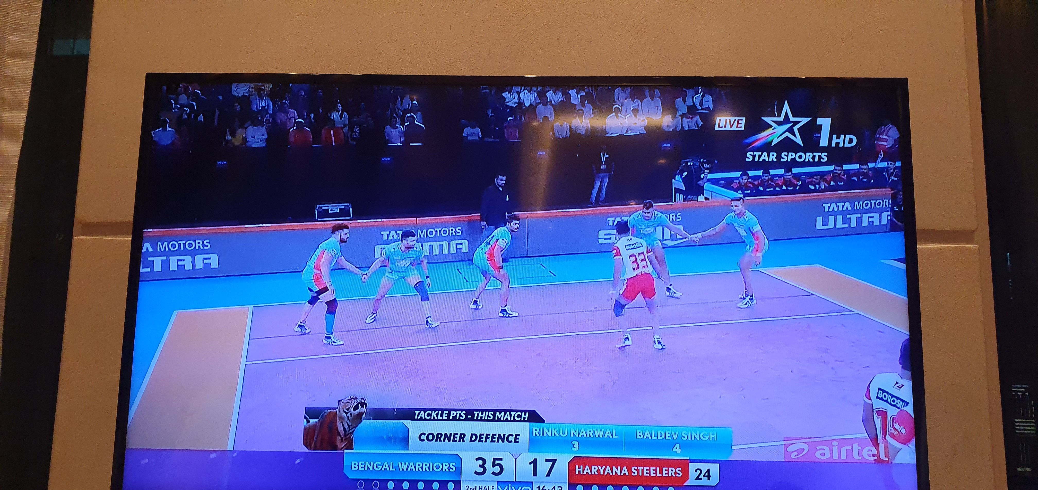
So pleased to be back in India
Notes:
OBS:SpeakerTopRight

Slide 10
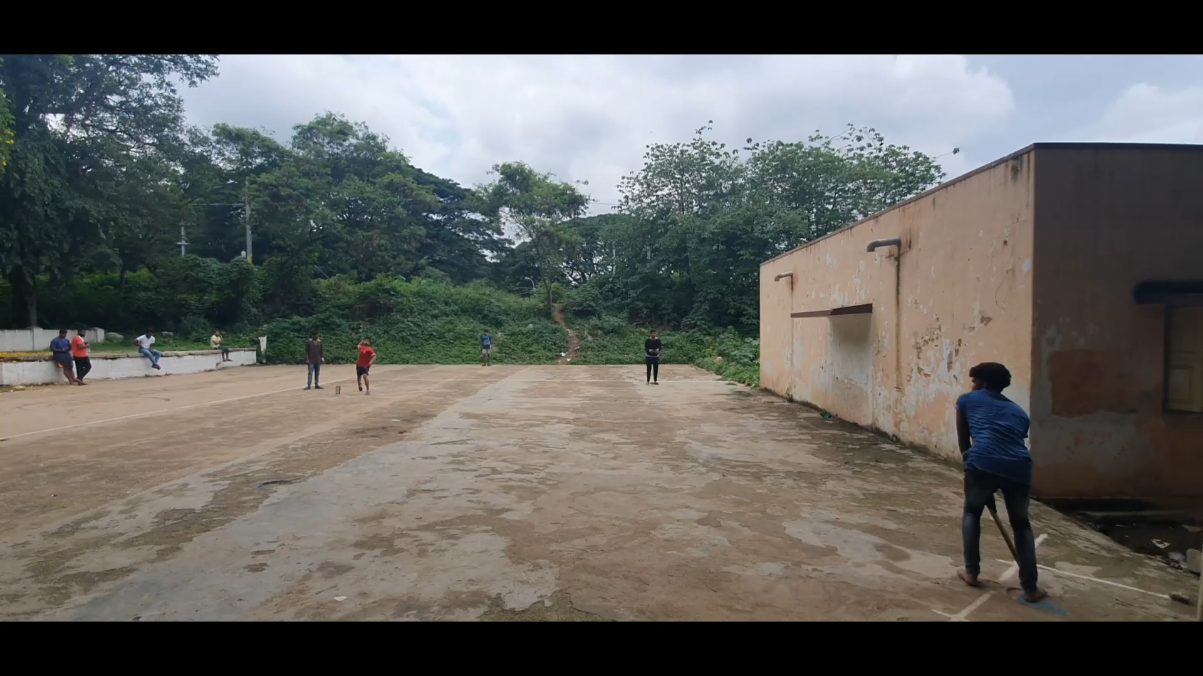
So pleased to be back in India
Notes:
OBS:SpeakerTopRight

Slide 11
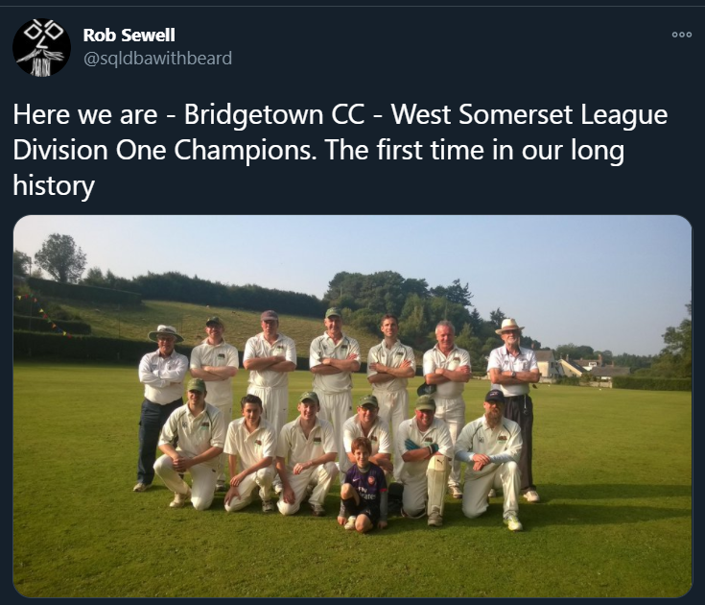
So pleased to be back in India
Notes:
OBS:SpeakerTopRight

Slide 12
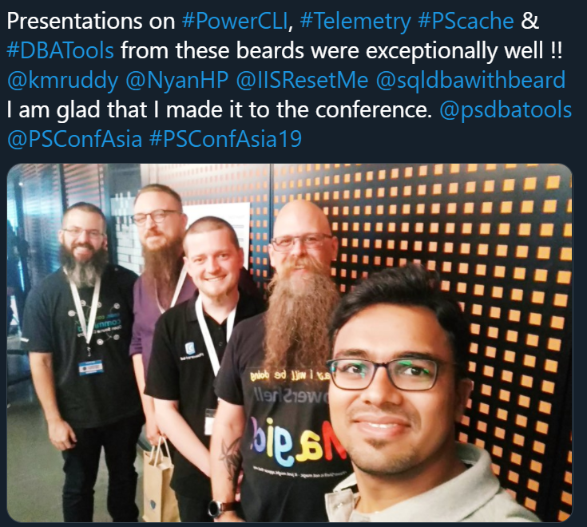
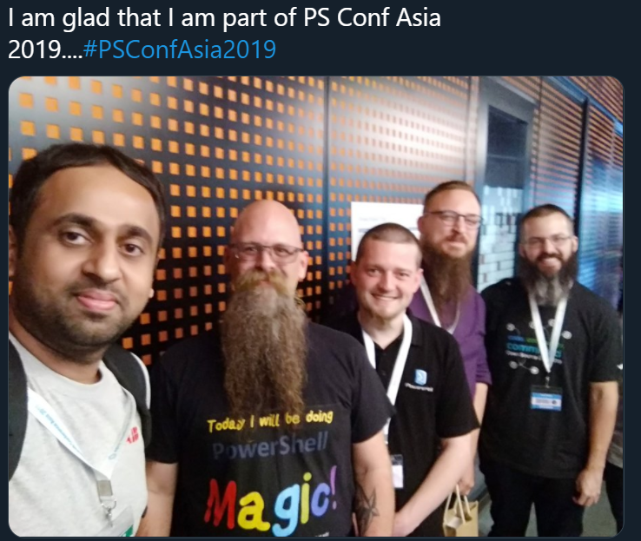
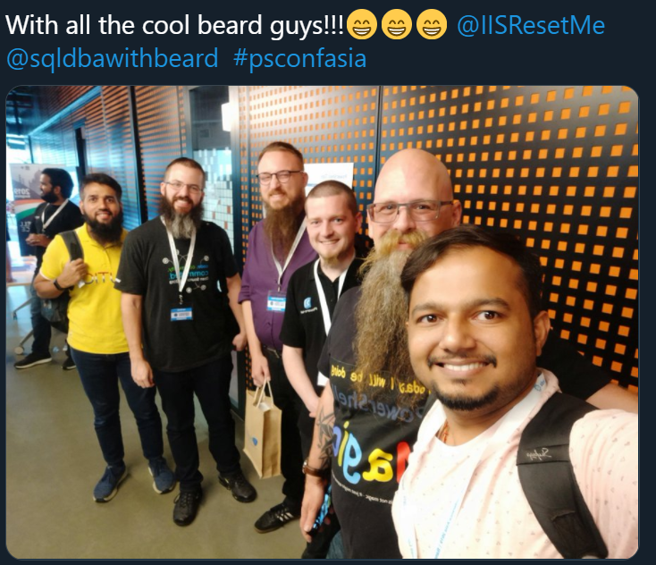
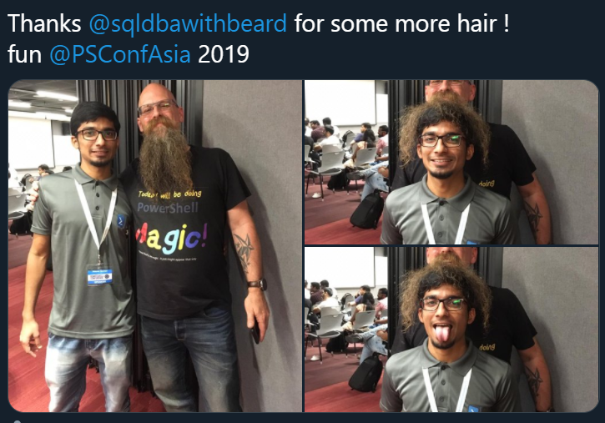
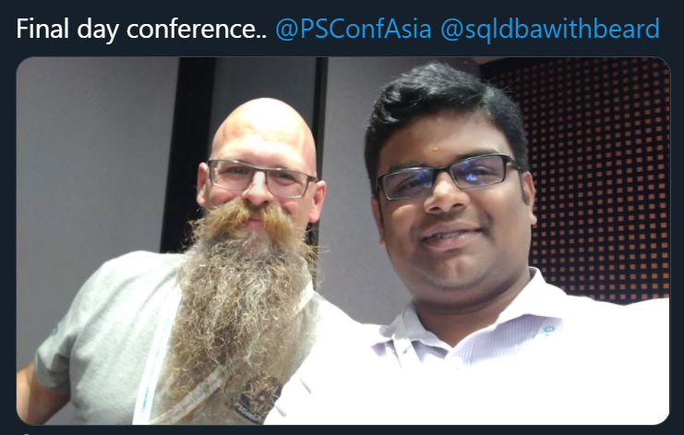
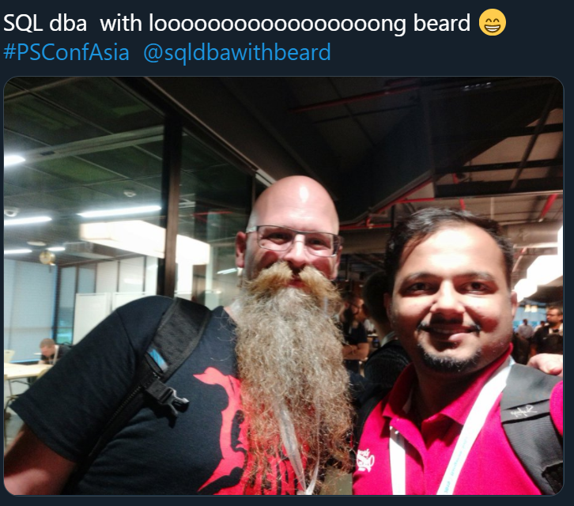
And I took some selfies!!

Slide 13
Thank You
Three Ways to Win Prizes
Post your selfie with hash tag #DPS2020
Give Session & Conference Feedback
Visit our Sponsors & Exhibitors
Follow us on Twitter @TheDataGeeks @DataAISummit

Slide 14
So feel free to take a selfie with me !!!
Notes:
OBS:SpeakerFull

Slide 15
Ask me questions anytime
Slides are always here - https://beard.media/presentations Notebooks are here - https://beard.media/Notebooks @SQLDbaWithBeard – Is where to find me later blog.robsewell.com – Is where to read things!
Notes:
OBS:Full Screen

Slide 16
Pop Quiz
In organisations – where is most data used ?
Notes:
OBS:Full Screen

Slide 17

Notes:
OBS:Full Screen

Slide 18
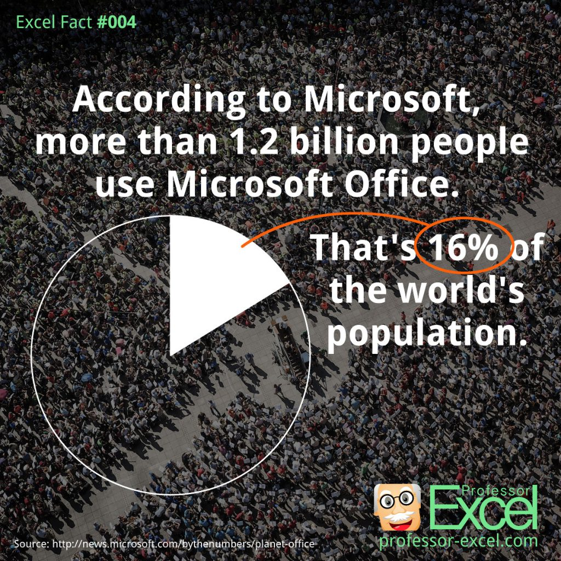
Notes:
OBS:SpeakerRightFull

Slide 19
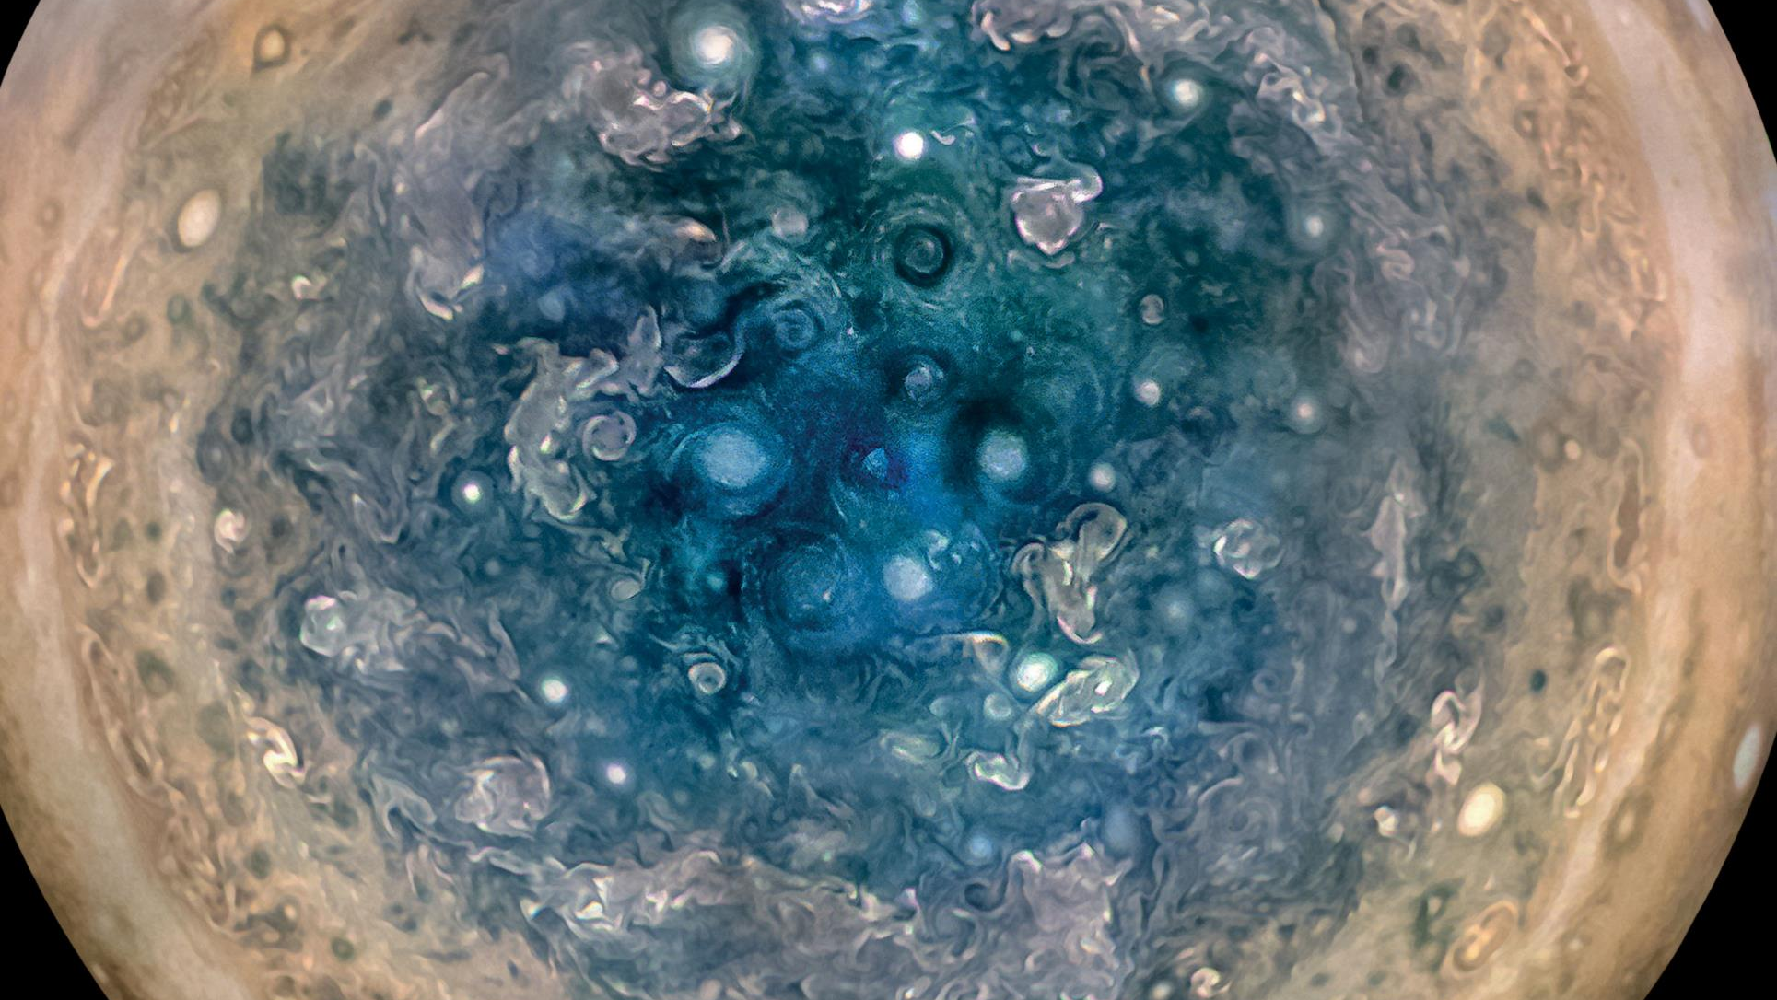
Notes:
OBS:Full Screen

Slide 20

So – What IS a Jupyter Notebook?
Originally for Data Scientists
Notes:
OBS:SpeakerTinySquare

Slide 21

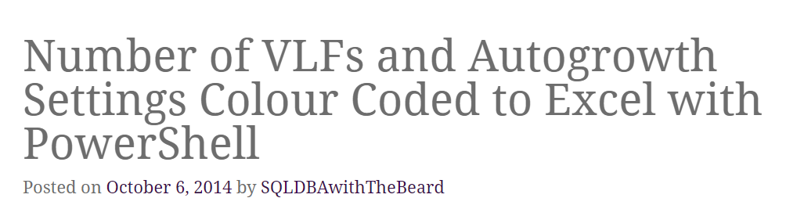

Slide 22
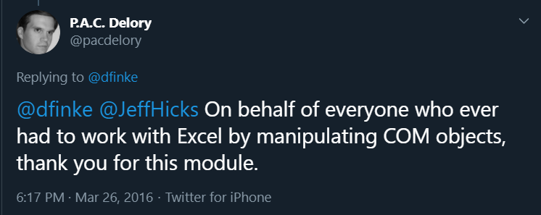

Slide 23




Special Thanks To
for supporting
DataPlatformGeeks & SQLServerGeeks
Community Initiatives

Slide 24
What is a Jupyter Notebook?
Document that can contain text, code, images and query results
Notes:
OBS:SpeakerCentreBottom

Slide 25
What is a Jupyter Notebook?
Document that can contain text, code, images and query results
Notes:
OBS:SpeakerCentreBottom

Slide 26
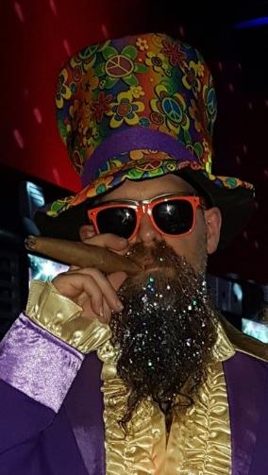
Time For A DEMO

